Slide 1
CS 105 Final Project
Presented by
Isiah Montalvo Amir Shirazi
Regan Jia
Xirong Xie
Samantha Nino

Slide 2
Project description
We are going to analyse a dataset about Valorant’s leaderboards. We will use the data to predict a player’s rank based on their headshot statistic with the K-means clustering method.

Slide 3
Techniques we use
K-means clustering
Elbow Method
Data cleaning

Slide 4
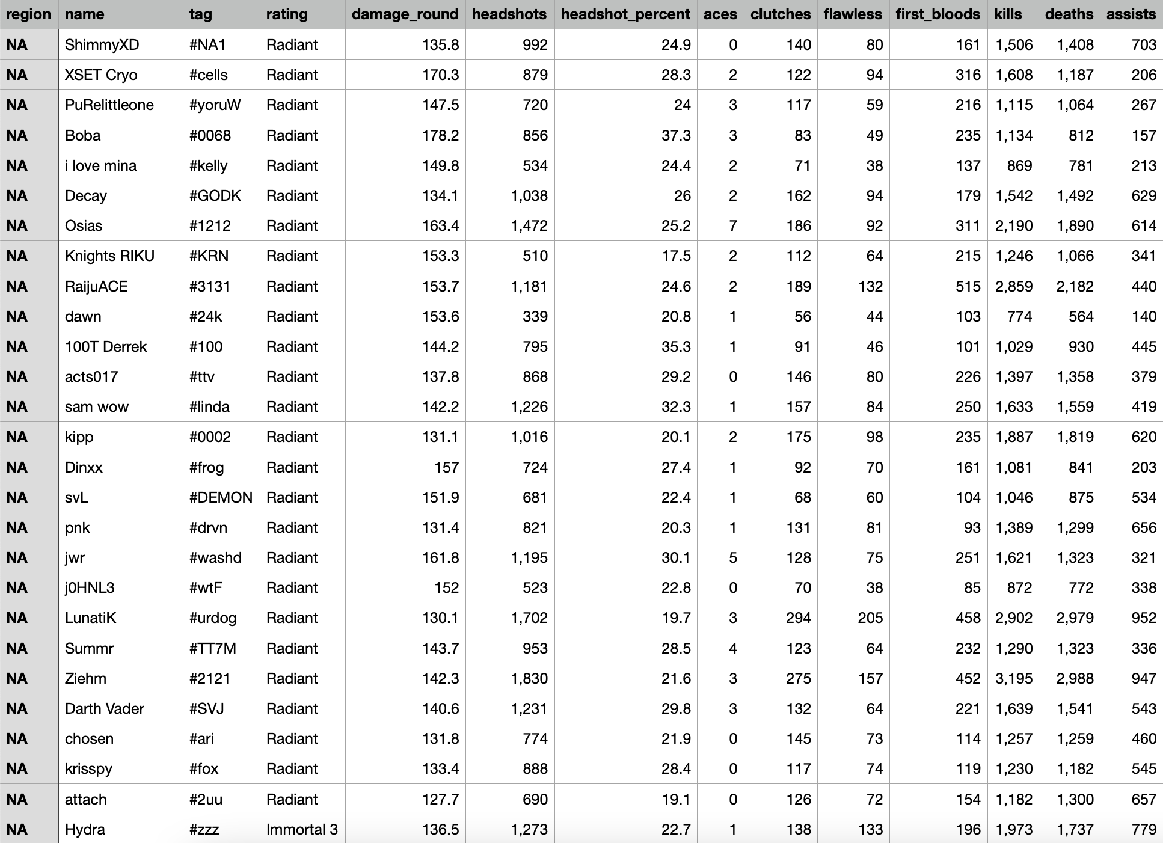
Dataset we use
Screenshot of dataset
Valorant Leaderboard Statistics
We will need the stats of players, including their rank, headshots, headshot percentage, etc
We can find these in the data set
When we do the data cleaning, we replace “,” with “ ”, and we also have different numbers represent for different gun names. In this case, we could just use numbers, which will be easier to make graphs.

Slide 5
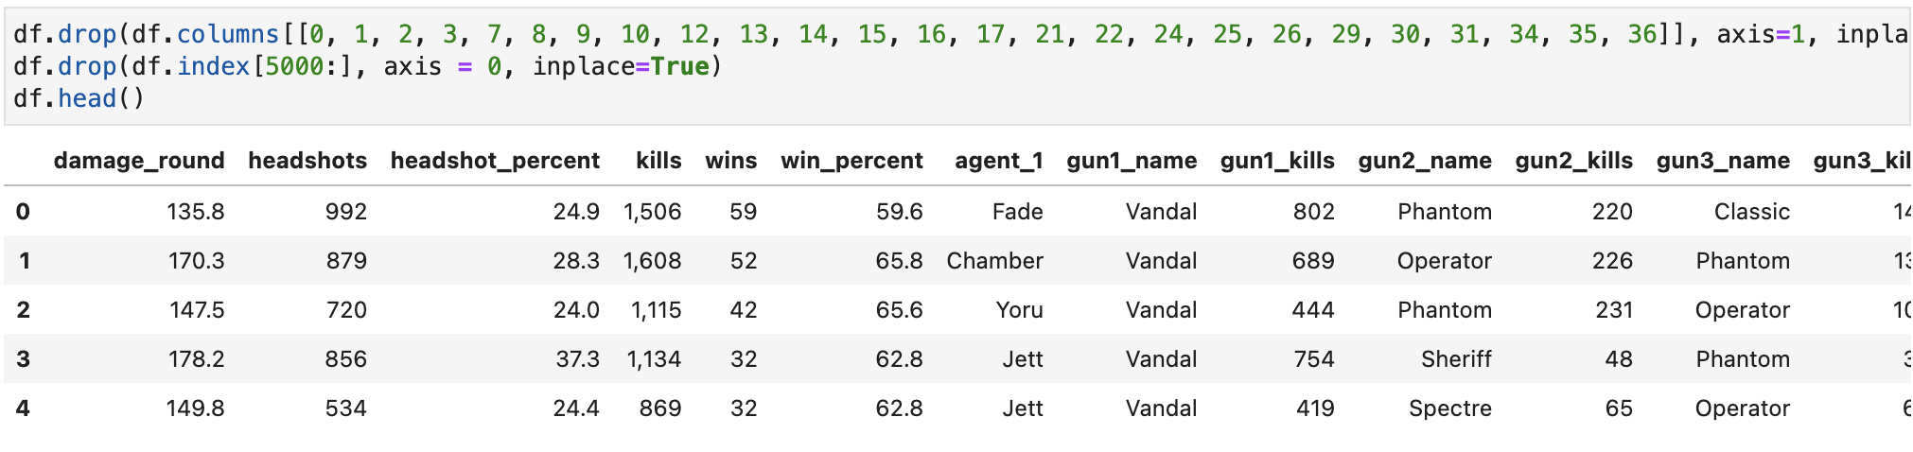
Dataset we use
Screenshot of dataset
Cleaned Data Set

Slide 6
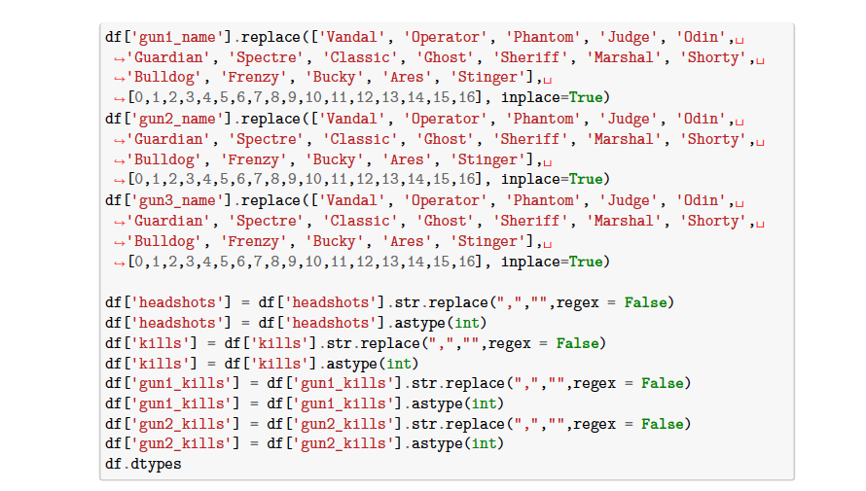
Data Cleaning

Slide 7
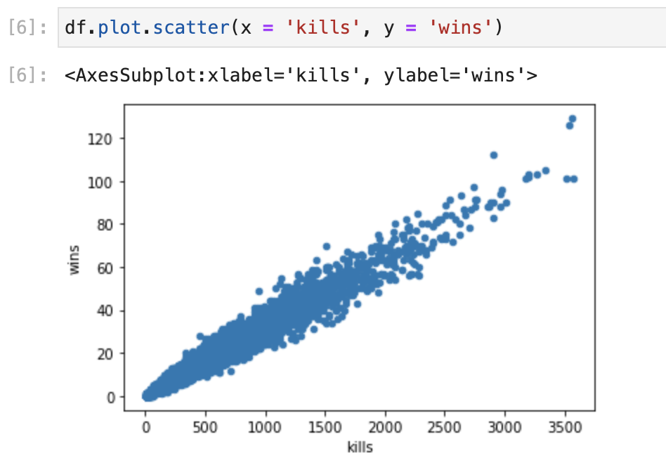
EDA
Screenshot from jupyter
Scatter plot that shows the correlation between the amount of kills and wins a player has
With this graph, we can see that the more kills a players has, the more wins they receive

Slide 8
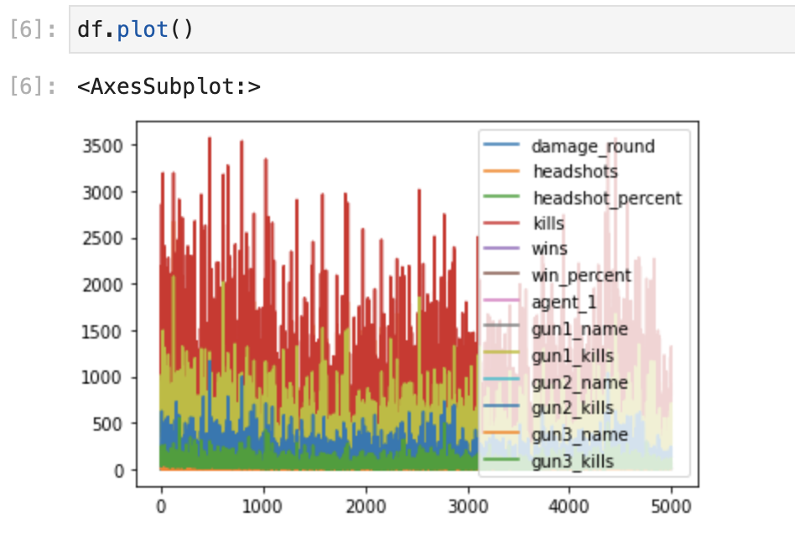
EDA

Slide 9
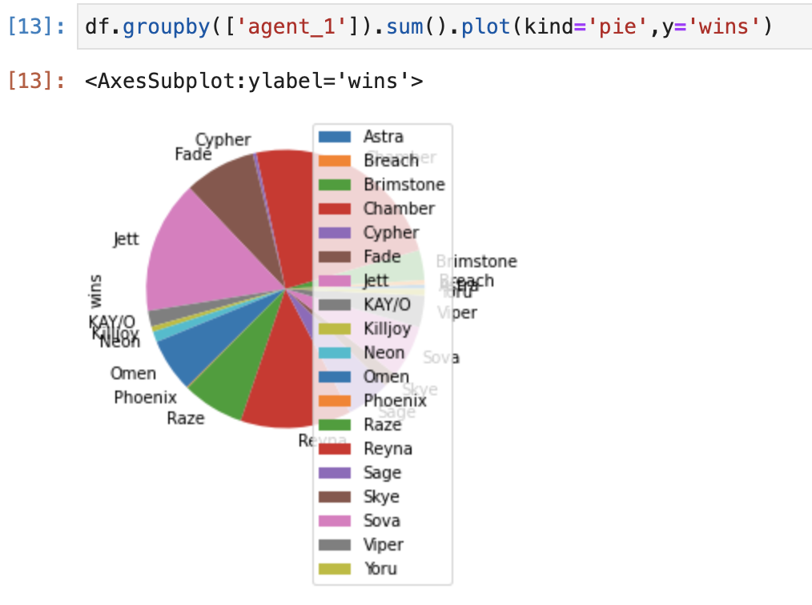
EDA
Screenshot from jupyter
Pie graph that shows the total amount of wins each agent has
Chamber, Jett, and Reyna has the most wins, Jett, and Reyna has the most wins

Slide 10
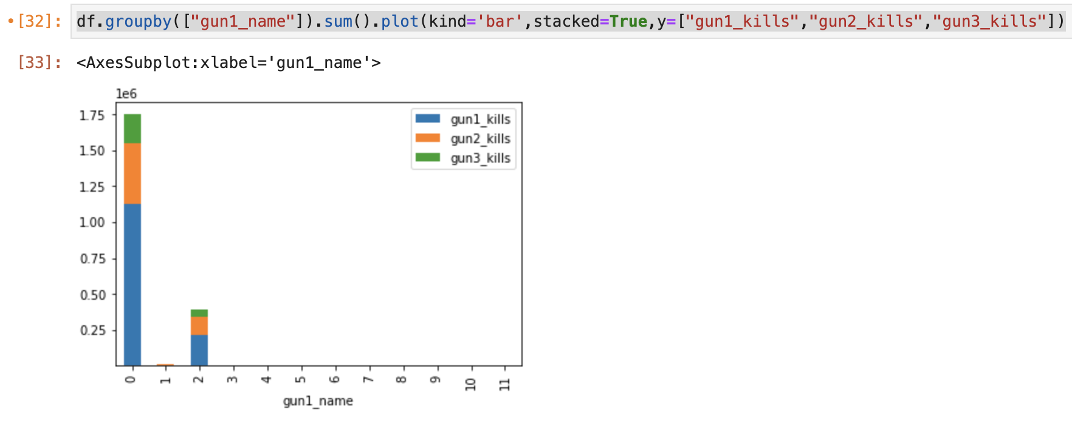
EDA
0: Vandal 10: Marshal
1: Operator 11: Shorty
2: Phantom
3: Judge
4: Odin
5: Guardian
6: Spectre
7: Classic
8: Ghost
9: Sheriff
Stacked bar graph to show which guns resulted in the most kills
We can see that Vandal(0) and Phantom(2) was the most used guns with the most kills

Slide 11
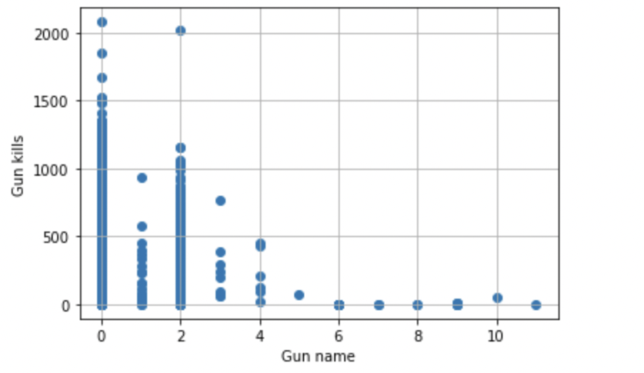
EDA
Scatter plot that shows the gun kills perspective to the gun name
Each point is an individual using that gun name (x-axis) and the amount of kills with that gun (y-axis)
Attached below is the respective numerical gun name to the actual gun name

Slide 12
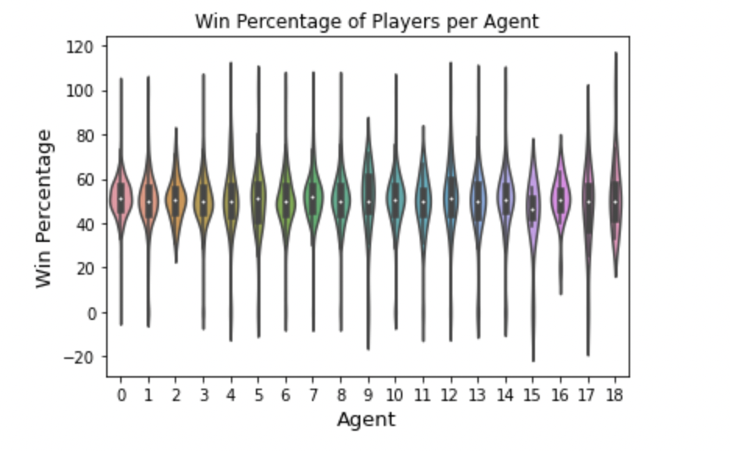
EDA
Violin plot displaying the agents that players play with the respective win rates
White circle indicates median
Attached below is the respective numerical agent name to the actual agent name

Slide 13
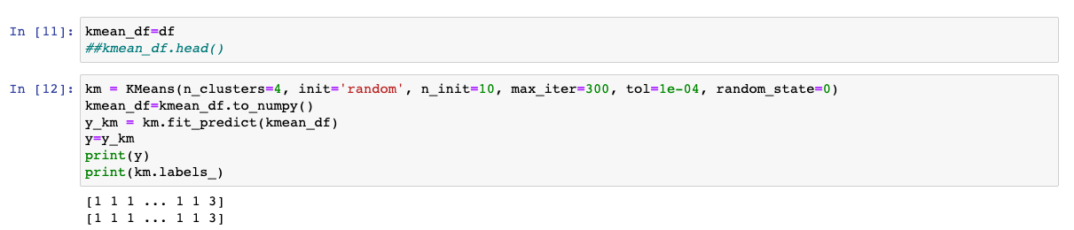
K-Means Clustering
Performed K-Means clustering to group players of similar Rank.
Set K=4, since there are four ratings Radiant, Immortal 3, Immortal 2, Immortal 1

Slide 14
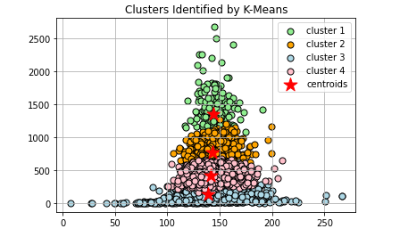
K-Means Clustering
We can see that through the use of k-means clustering, we were able to successfully cluster the headshot data into 4 distinct player rankings that confirm our intuition. With cluster 1 being the best players with the highest headshot ratings and cluster 4 being the lower ranked players with lower headshot ratings. We can see that the graph and clusters tighten up as headshot rating increases implying that there are a lower amount of players able to achieve that level of play. We see that cluster 1 has a few standout outliers that go far beyond their predecessors, clusters 2 and 3 are fairly tight knit with most players being very similar in skill and cluster 4 has the most variance with both low and high outliers at the lower ranks.

Slide 15
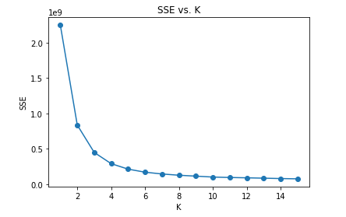
Elbow Method
Visualization method to estimate the optimal number of K Clusters.
Using within-clusters Sum of Square Error to measure the variability.
We pick the optimal K by finding the elbow in the plot.
We can notice that the elbow is at K=4.

Slide 16
Questions for you
Q1: What do the clusters represent and what pattern did the data form as the headshot rating increased
Q2: What agent had the highest contribution to a players wins?
Q3: How could clustering be used to improve matchmaking in competitive games?

Slide 17
Thank you for watching this video!

